Slide 1

Computing Algorithms Lecture 6: Decrease and Conquer
By: Dr. Mohamed Moheeb

Slide 2
Agenda
Depth first search and Breadth first search (brute force)
Introduction
Insertion sort
Topological sort

Slide 3

DFS and BFS

Slide 4
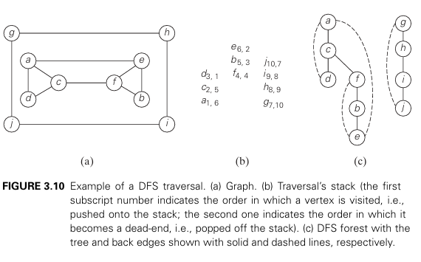
Depth First Search (DFS)
Book: Introduction to the Design and Analysis of Algorithms

Slide 5
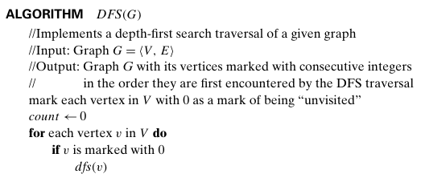
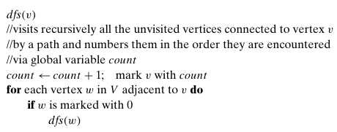
DFS algorithm

Slide 6
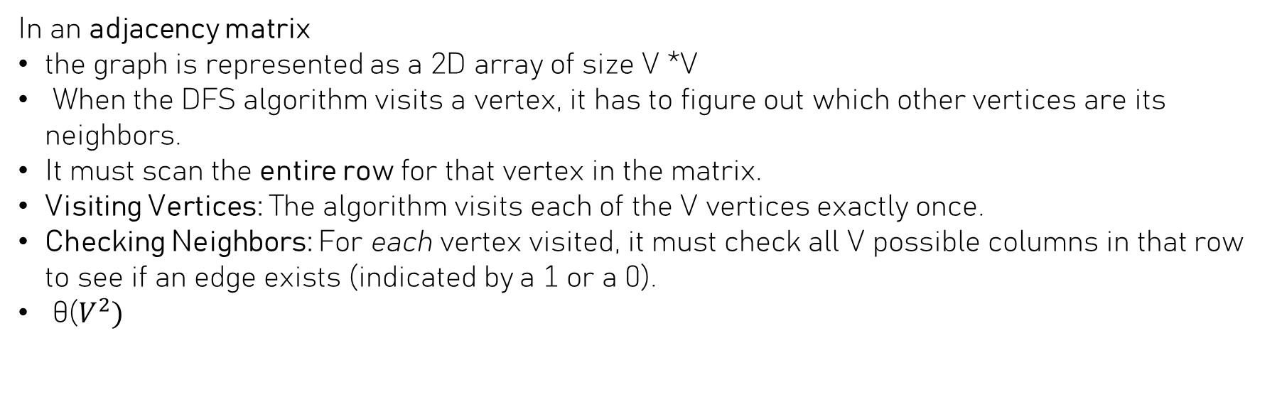
DFS time complexity
In an adjacency matrix
the graph is represented as a 2D array of size V *V
When the DFS algorithm visits a vertex, it has to figure out which other vertices are its neighbors.
It must scan the entire row for that vertex in the matrix.
Visiting Vertices: The algorithm visits each of the V vertices exactly once.
Checking Neighbors: For each vertex visited, it must check all V possible columns in that row to see if an edge exists (indicated by a 1 or a 0).
θ($V^{2})$

Slide 7
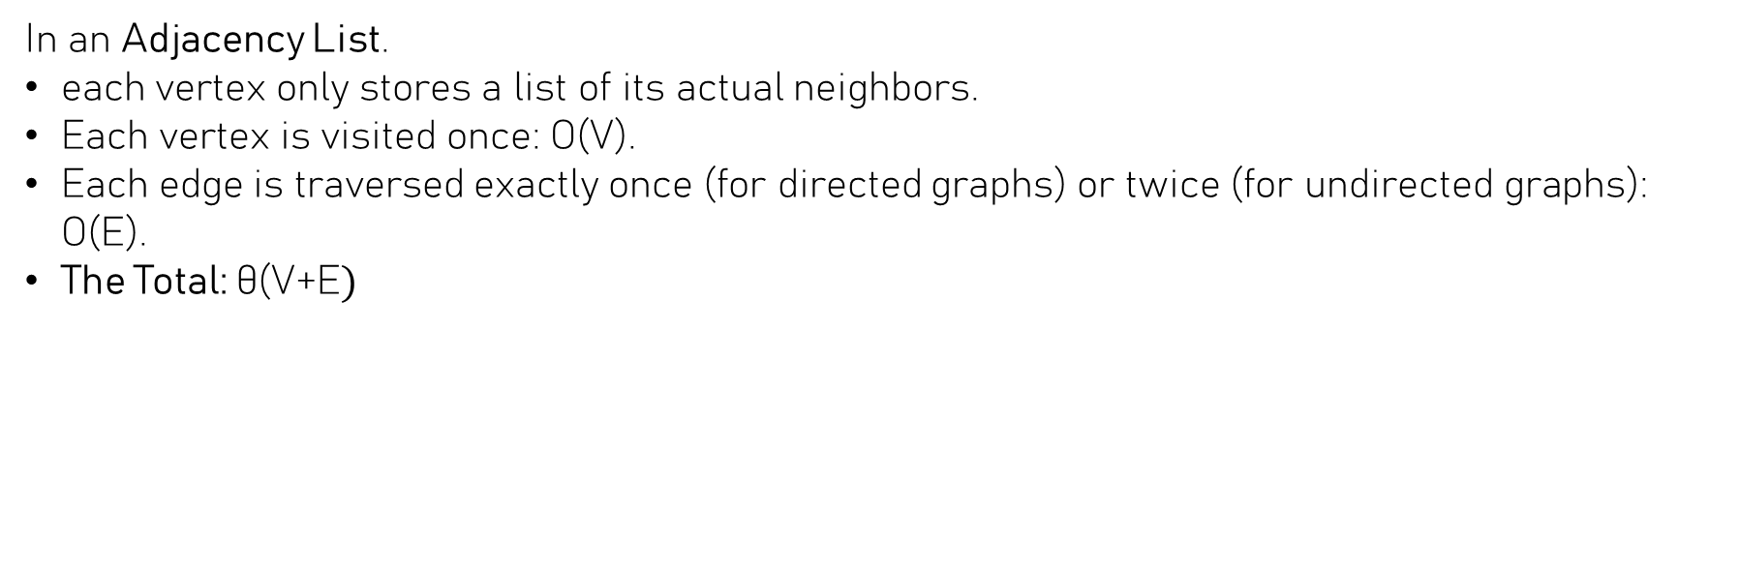
DFS time complexity
In an Adjacency List.
each vertex only stores a list of its actual neighbors.
Each vertex is visited once: O(V).
Each edge is traversed exactly once (for directed graphs) or twice (for undirected graphs): O(E).
The Total: θ(V+E$)$

Slide 8
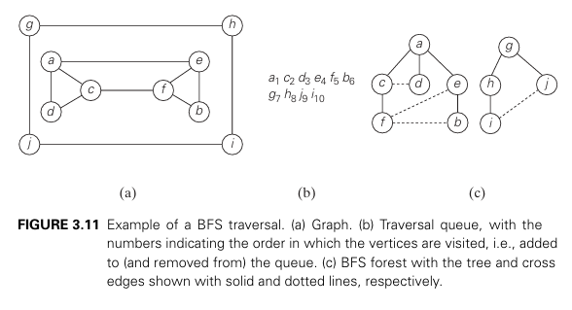
Breadth First Search (BFS)
Book: Introduction to the Design and Analysis of Algorithms

Slide 9
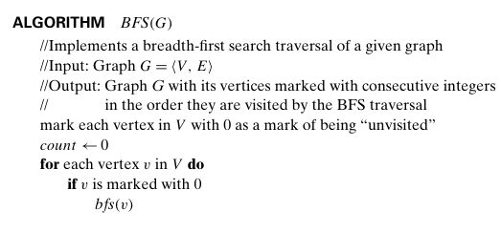
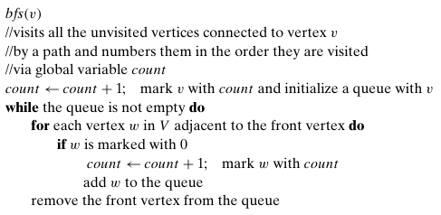
BFS Algorithm

Slide 10
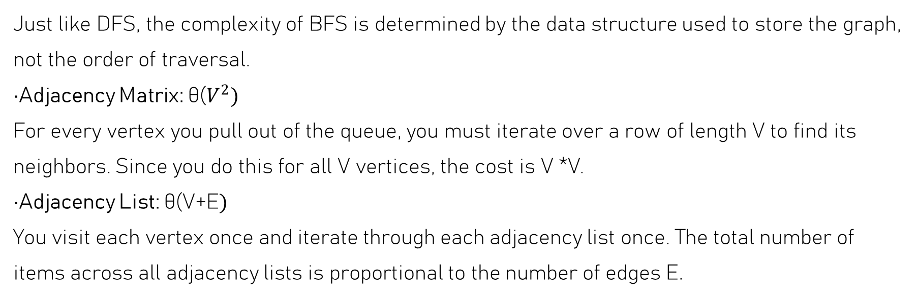
BFS time complexity
Just like DFS, the complexity of BFS is determined by the data structure used to store the graph, not the order of traversal.
Adjacency Matrix: θ($V^{2})$
For every vertex you pull out of the queue, you must iterate over a row of length V to find its neighbors. Since you do this for all V vertices, the cost is V *V.
Adjacency List: θ(V+E$)$
You visit each vertex once and iterate through each adjacency list once. The total number of items across all adjacency lists is proportional to the number of edges E.

Slide 11

Decrease and Conquer

Slide 12
Introduction
The decrease-and-conquer technique is based on exploiting the relationship between a solution to a given instance of a problem and a solution to its smaller instance.
There are three major variations of decrease-and-conquer:
Decrease by a constant
Decrease by a constant factor
variable size decrease

Slide 13
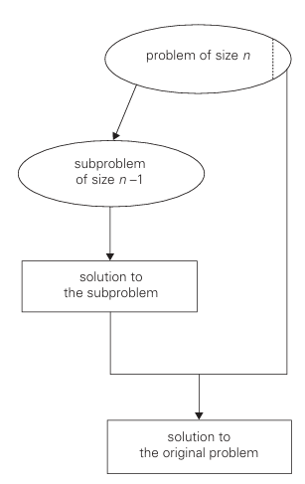
Decrease by a constant
decrease-by-a-constant variation, the size of an instance is reduced by the same constant on each iteration of the algorithm. Typically, this constant is equal to one, although other constant size reductions do happen occasionally.
Book: Introduction to the Design and Analysis of Algorithms

Slide 14
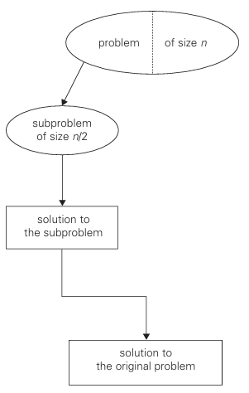
Decrease by a constant factor
The decrease-by-a-constant-factor technique suggests reducing a problem instance by the same constant factor on each iteration of the algorithm
Book: Introduction to the Design and Analysis of Algorithms

Slide 15
Variable-size-decrease
the variable-size-decrease variety of decrease-and-conquer, the size-reduction pattern varies from one iteration of an algorithm to another.
Euclid’s algorithm for computing the greatest common divisor provides a good example of such a situation.
Recall that this algorithm is based on the formula gcd(m, n) =gcd(n, m mod n)

Slide 16
Insertion sort

Slide 17
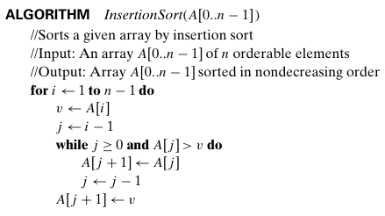
Insertion sort
i
0 | 1 | 2 | 3 | 4
14 | 21 | 1 | 12 | 14
Let’s trace the insertion sort on this given array of size n=5
First the for loop i=1 till it reach n-1 or in this case 4
Variables
i=1

Slide 18
Insertion sort
i
0 | 1 | 2 | 3 | 4
14 | 21 | 1 | 12 | 14
Initialize variable v to value of A[i] which A[1] = 21
Variables
i=1
v=21

Slide 19
Insertion sort
j
i
0 | 1 | 2 | 3 | 4
14 | 21 | 1 | 12 | 14
Initialize j to i-1 which will be equal to 0
Variables
i=1
v=21
j=0

Slide 20
Insertion sort
j
i
0 | 1 | 2 | 3 | 4
14 | 21 | 1 | 12 | 14
Check the while loop condition if j is bigger than or equal 0 which is true and A[j] is bigger than v which is false
So we skip the while loop
Variables
i=1
v=21
j=0

Slide 21
Insertion sort
j
i
0 | 1 | 2 | 3 | 4
14 | 21 | 1 | 12 | 14
Check the while loop condition if j is bigger than or equal 0 which is true and A[j] is bigger than v which is false
So we skip the while loop
Variables
i=1
v=21
j=0

Slide 22
Insertion sort
j
i
0 | 1 | 2 | 3 | 4
14 | 21 | 1 | 12 | 14
We now set the value of A[j+1] to be equal to v which is setting the value of A[1]=21 which will stay the same.
Variables
i=1
v=21
j=0

Slide 23
Insertion sort
i
0 | 1 | 2 | 3 | 4
14 | 21 | 1 | 12 | 14
Increment the value of i by 1 to be equal to 2
Variables
i=2

Slide 24
Insertion sort
i
0 | 1 | 2 | 3 | 4
14 | 21 | 1 | 12 | 14
Set the variable v to A[i] or A[2] = 1
Variables
i=2
v=1

Slide 25
Insertion sort
j
i
0 | 1 | 2 | 3 | 4
14 | 21 | 1 | 12 | 14
Value of j to i-1 which will be equal to 1
Variables
i=2
v=1
j=1

Slide 26
Insertion sort
j
i
0 | 1 | 2 | 3 | 4
14 | 21 | 1 | 12 | 14
Check the while loop condition if j is bigger than or equal 0 which is true and A[j] or A[1]=21 is bigger than v or 1 which is true
Variables
i=2
v=1
j=1

Slide 27
Insertion sort
j
i
0 | 1 | 2 | 3 | 4
14 | 21 | 1 | 12 | 14
21
The value of A[j] will override the value of A[j+1] or A[2]=21
Variables
i=2
v=1
j=1

Slide 28
Insertion sort
j
i
0 | 1 | 2 | 3 | 4
14 | 21 | 1 | 12 | 14
21
The value of j is decremented by 1
Variables
i=2
v=1
j=0

Slide 29
Insertion sort
j
i
0 | 1 | 2 | 3 | 4
14 | 21 | 21 | 12 | 14
Check the while loop condition if j is bigger than or equal 0 which is true and A[j] or A[0]=14 is bigger than v or 1 which is true
Variables
i=2
v=1
j=0

Slide 30
Insertion sort
j
i
0 | 1 | 2 | 3 | 4
14 | 21 | 21 | 12 | 14
14
The value of A[j] will override the value of A[j+1] or A[1]=14
Variables
i=2
v=1
j=0

Slide 31
Insertion sort
i
j
0 | 1 | 2 | 3 | 4
14 | 21 | 21 | 12 | 14
14
Decrement j by 1
Variables
i=2
v=1
j=-1

Slide 32
Insertion sort
i
0 | 1 | 2 | 3 | 4
14 | 14 | 21 | 12 | 14
Check the while loop condition if j is bigger than or equal -1 which is false
Variables
i=2
v=1
j=-1

Slide 33
Insertion sort
i
0 | 1 | 2 | 3 | 4
14 | 14 | 21 | 12 | 14
1
The value of A[j+1] or A[0] will be set to 1
Variables
i=2
v=1
j=-1

Slide 34
Insertion sort
i
0 | 1 | 2 | 3 | 4
1 | 14 | 21 | 12 | 14
Increase the value of i by 1 which is equal to 3
Variables
i=3

Slide 35
Insertion sort
i
0 | 1 | 2 | 3 | 4
1 | 14 | 21 | 12 | 14
Set the variable v =A[i]=A[3]=12
Variables
i=3
v=12

Slide 36
Insertion sort
j
i
0 | 1 | 2 | 3 | 4
1 | 14 | 21 | 12 | 14
set j to i-1 =3-1=2
Variables
i=3
v=12
j=2

Slide 37
Insertion sort
j
i
0 | 1 | 2 | 3 | 4
1 | 14 | 21 | 12 | 14
Check the while loop condition if j is bigger than or equal 0 which is true and A[j] or A[2]=21 is bigger than v or 12 which is true
Variables
i=3
v=12
j=2

Slide 38
Insertion sort
j
i
0 | 1 | 2 | 3 | 4
1 | 14 | 21 | 12 | 14
21
The value of A[j] will override the value of A[j+1] or A[3]=21
Variables
i=3
v=12
j=2

Slide 39
Insertion sort
j
i
0 | 1 | 2 | 3 | 4
1 | 14 | 21 | 12 | 14
21
Decrement j by 1 equal 1
Variables
i=3
v=12
j=1

Slide 40
Insertion sort
j
i
0 | 1 | 2 | 3 | 4
1 | 14 | 21 | 21 | 14
Check the while loop condition if j is bigger than or equal 0 which is true and A[j] or A[1]=14 is bigger than v or 12 which is true
Variables
i=3
v=12
j=1

Slide 41
Insertion sort
j
i
0 | 1 | 2 | 3 | 4
1 | 14 | 21 | 21 | 14
14
The value of A[j] will override the value of A[j+1] or A[2]=14
Variables
i=3
v=12
j=1

Slide 42
Insertion sort
j
i
0 | 1 | 2 | 3 | 4
1 | 14 | 21 | 21 | 14
14
Decrease the j by 1
Variables
i=3
v=12
j=0

Slide 43
Insertion sort
j
i
0 | 1 | 2 | 3 | 4
1 | 14 | 14 | 21 | 14
Check the while loop condition if j is bigger than or equal 0 which is true and A[j] or A[0]=1 is bigger than v or 12 which is false
Variables
i=3
v=12
j=0

Slide 44
Insertion sort
j
i
0 | 1 | 2 | 3 | 4
1 | 14 | 14 | 21 | 14
12
The value of A[j+1] or A[1] will be set to v or 12
Variables
i=3
v=12
j=0

Slide 45
Insertion sort
j
i
0 | 1 | 2 | 3 | 4
1 | 14 | 14 | 21 | 14
12
The value of A[j+1] or A[1] will be set to v or 12
Variables
i=3
v=12
j=0

Slide 46
Insertion sort
i
0 | 1 | 2 | 3 | 4
1 | 12 | 14 | 21 | 14
Increment the value of i by 1 which is equal to 4
Variables
i=4

Slide 47
Insertion sort
j
i
0 | 1 | 2 | 3 | 4
1 | 12 | 14 | 21 | 14
Set v to A[i] which equal to A[4] or 14
Variables
i=4
V=14
j= 3

Slide 48
Insertion sort
j
i
0 | 1 | 2 | 3 | 4
1 | 12 | 14 | 21 | 14
Set j to i-1 which equal to 3
Variables
i=4
v=14
j= 3

Slide 49
Insertion sort
j
i
0 | 1 | 2 | 3 | 4
1 | 12 | 14 | 21 | 14
Check the while loop condition if j is bigger than or equal 0 which is true and A[j] or A[3]=21 is bigger than v or 14 which is true
Variables
i=4
v=14
j= 3

Slide 50
Insertion sort
j
i
0 | 1 | 2 | 3 | 4
1 | 12 | 14 | 21 | 14
21
The value of A[j] will override the value of A[j+1] or A[4]=21
Variables
i=4
v=14
j= 3

Slide 51
Insertion sort
j
i
0 | 1 | 2 | 3 | 4
1 | 12 | 14 | 21 | 14
21
Decrement the value of j by 1 which is equal to 2
Variables
i=4
v=14
j= 2

Slide 52
Insertion sort
j
i
0 | 1 | 2 | 3 | 4
1 | 12 | 14 | 21 | 21
Check the while loop condition if j is bigger than or equal 0 which is true and A[j] or A[2]=14 is bigger than v or 14 which is false
Variables
i=4
v=14
j= 2

Slide 53
Insertion sort
j
i
0 | 1 | 2 | 3 | 4
1 | 12 | 14 | 21 | 21
14
The value of A[j+1] or A[3] will be set to v or 14
Variables
i=4
v=14
j= 2

Slide 54
Insertion sort
i
0 | 1 | 2 | 3 | 4
1 | 12 | 14 | 14 | 21
Increment the value of i by 1 which is equal to 5 which exceeds the value of n-1 or 4
The array is now sorted
Variables
i=5

Slide 55
Brute force vs Decrease and Conquer
Brute Force (e.g., Selection Sort): Scans the entire unsorted list to find the absolute minimum, then swaps it. It doesn't care about the structure of what remains; it just repeats the "search all" process $V$ times.
Decrease-and-Conquer (Insertion Sort): It assumes a sub-problem of size n-1 is already solved (sorted). To solve the problem for size n, it only takes the n-th element and "inserts" it into that already-solved portion.

Slide 56
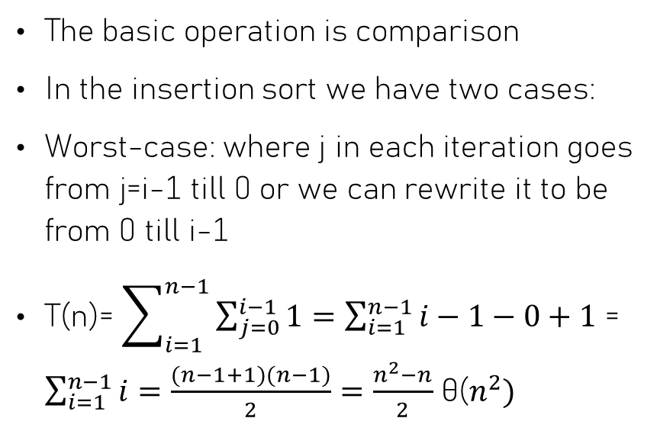
Insertion sort Time Analysis
The basic operation is comparison
In the insertion sort we have two cases:
Worst-case: where j in each iteration goes from j=i-1 till 0 or we can rewrite it to be from 0 till i-1
T(n)= $\sum_{i=1}^{n−1}{\sum_{j=0}^{i−1}{1}=\sum_{i=1}^{n−1}{i−1−0+1}}$ = $\sum_{i=1}^{n−1}{i}=\frac{(n−1+1)(n−1)}{2}=\frac{n^{2}−n}{2}$ θ($n^{2})$

Slide 57
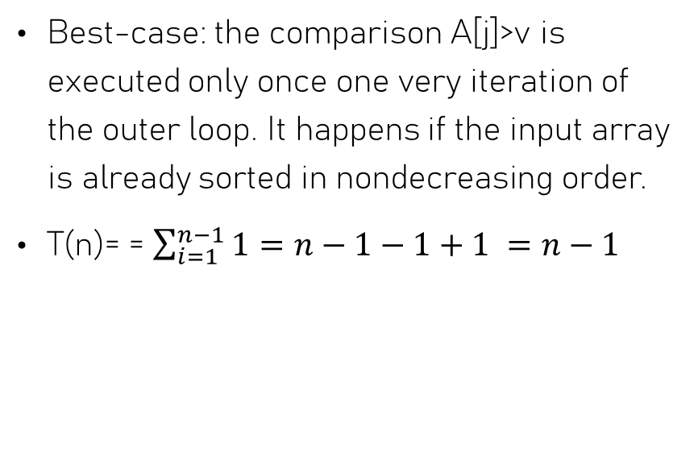

Insertion sort Time Analysis
Best-case: the comparison A[j]>v is executed only once one very iteration of the outer loop. It happens if the input array is already sorted in nondecreasing order.
T(n)= = $\sum_{i=1}^{n−1}{1}=n−1−1+1 =n−1$
θ(n$)$

Slide 58
Topological Sorting

Slide 59
What is Topological Sorting
Topological Sorting is a linear ordering of nodes in a Directed Acyclic Graph (DAG) such that for every directed edge from node u to node v, u always appears before v.
Example:
University Course Prerequisites: You can't take computing Alogrithm until you've passed Data structure.
Build Systems (like Make or Gradle): Compiling a software project requires compiling libraries in a specific order based on their dependencies.
there are two algorithm defined to sort them:
Depth-first search
Source removal

Slide 60
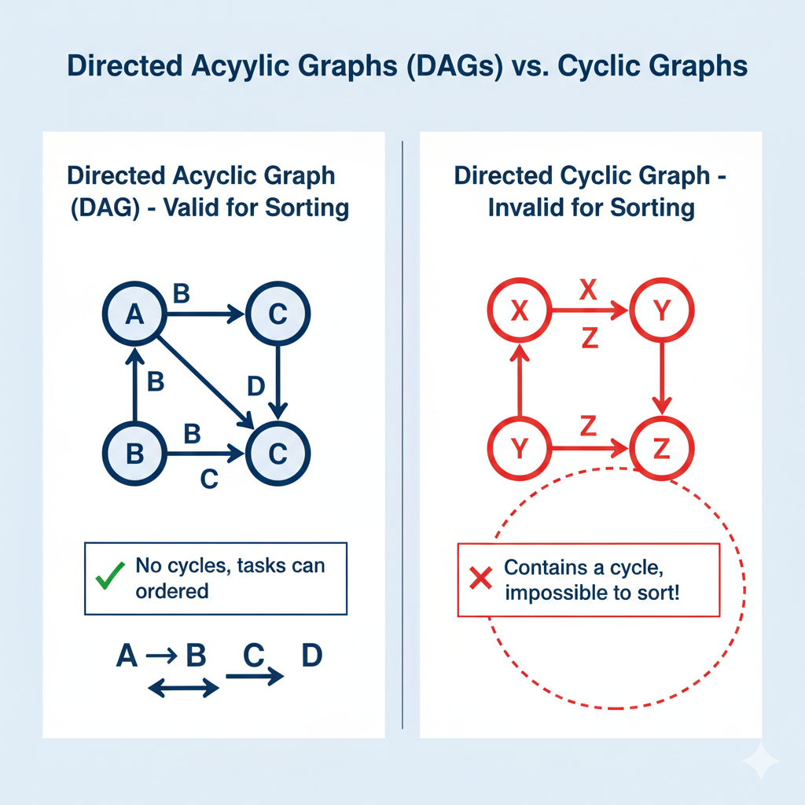
Directed Acyclic Graph (DAG)

Slide 61
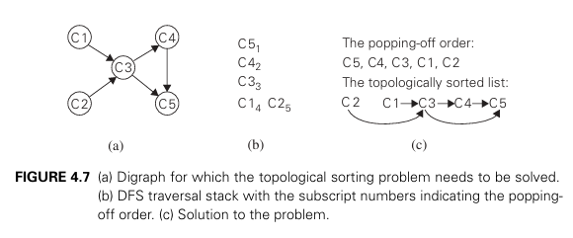
DFS based Algorithm
Book: Introduction to the Design and Analysis of Algorithms

Slide 62
DFS based Algorithm
Performa DFS traversal and note the order in which vertices become dead-ends (i.e., popped off the traversal stack).
Reversing this order yields a solution to the topological sorting problem, provided, of course, no back edge has been encountered during the traversal.
If a back edge has been encountered, the digraph is not a dag, and topological sorting of its vertices is impossible
When a vertex v is popped off a DFS stack, no vertex u with an edge from u to v can be among the vertices popped off before v. (Otherwise, (u, v) would have been a back edge.)

Slide 63
DFS based algorithm Time Analysis
While DFS is an exhaustive traversal technique, the Topological Sort algorithm uses it to implement Decrease-and-Conquer. It systematically identifies a node that can be 'finished' (the conquer step), effectively removing it from the dependency web and reducing the problem to a smaller sub-graph (the decrease step).
DFS-based sorting is efficient because it follows the arrows. It uses the edges E as a roadmap to find the "end" of the dependency chain
Visit each Vertex V: The algorithm visits each node exactly once. We mark nodes as "visiting" or "visited" so we never repeat work.
Explore each Edge E: For every node, we look at its outgoing edges to see where to go next. Each edge is crossed exactly once.
DFS-based sorting is O(V+E) because it uses the graph's structure to reduce the problem size.

Slide 64
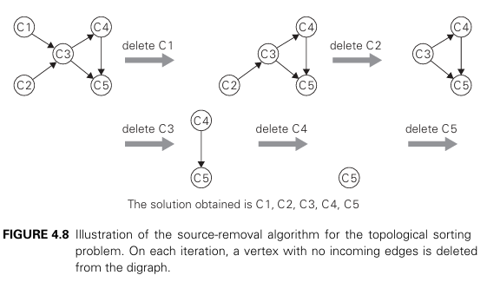
Source removal algorithm
Book: Introduction to the Design and Analysis of Algorithms

Slide 65
Source removal algorithm
Calculate Indegrees: For every node in the graph, count how many incoming edges (prerequisites) it has.
Identify the "Sources": Find all nodes with an indegree of 0 (no prerequisites) and place them into a queue.
Process and "Remove": While the queue isn't empty, pull a node out, add it to your sorted list, and "delete" its outgoing edges from the graph.
Update and Repeat: For every neighbor you just "freed," decrement its indegree count. If its count hits 0, add it to the queue and repeat until the queue is empty.

Slide 66
Source-removal Time Analysis
Time complexity is also: O(V + E)
Each Vertex V: Every node is placed into a queue and removed exactly once.
Each Edge E: When a node is removed, the algorithm looks at all its outgoing edges to "decrement" the indegree of its neighbors.
Since each edge is attached to exactly one source, each edge is processed exactly once.

